Slide 1

Airline Flight Delay Data Processing and Analysis Pipeline
This presentation outlines a comprehensive data processing and analysis pipeline for airline flight delay data, covering data ingestion, cleaning, storage, advanced analysis, and data governance.
By Group 2 -
Kalpit Sharma(G23AI2065) Priyank Bhardwaj (G23AI2038) Shubhankit Dutt (G23AI2070) Nihar Dave (G23AI2097) Ankush Jha (G23AI2007) Dhanshree Hood (G23AI2132)​

Slide 2
Phase 1: Data Ingestion, Cleaning, and Exploratory Data Analysis (EDA)
Data Loading and Exploration
Data Cleaning
The first step involves loading the dataset from a CSV file and an Excel file containing column definitions. We explore the data structure, types, and missing values, calculating descriptive statistics and displaying a sample preview.
Data cleaning involves converting columns to numeric types, handling missing values, detecting outliers, and standardizing date formats.
Conversion of Columns: Certain columns are expected to be numeric, so any non-numeric values are coerced to NaN (Not a Number).
Data Structure: This step checks the column types, total number of records, and any missing values in the dataset.
Handling Missing Values: Missing data is filled using either the mean (for numeric columns) or the mode (for categorical columns).
Descriptive Statistics: This helps summarize the data by calculating measures like mean, median, and standard deviation for numeric columns.
Outlier Detection: We calculate the Z-score for each numeric column and remove data points that are more than 3 standard deviations away from the mean, which are considered outliers.
Missing Values: We inspect which columns contain missing data and determine how to handle them.
Standardizing Date Format: If there are any date-related columns, they are converted to a consistent datetime format.
Sample Data: A preview of the first few rows is displayed to understand the content and format of the data.
Column Definitions: The corresponding column definitions are loaded from the Excel file to interpret the data correctly.

Slide 3
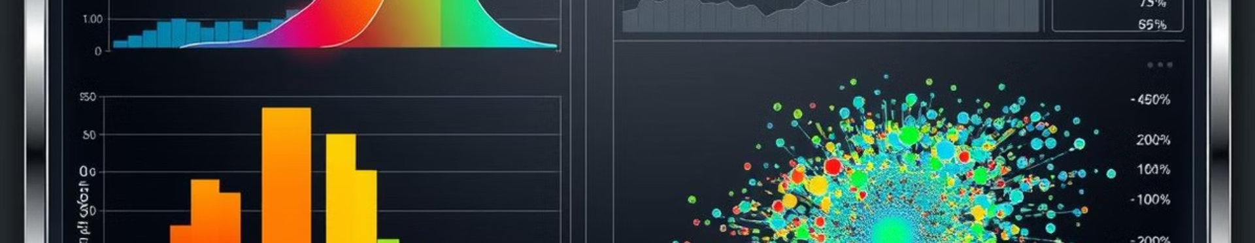
Exploratory Data Analysis (EDA)
Distribution of Features:-
Correlation Heatmap:-
Visualizations are created to understand the distribution of each numeric feature, identifying skewness, normality, or anomalies.
A heatmap is generated to visualize the correlations between different numeric features, identifying potential relationships or dependencies.

Slide 4
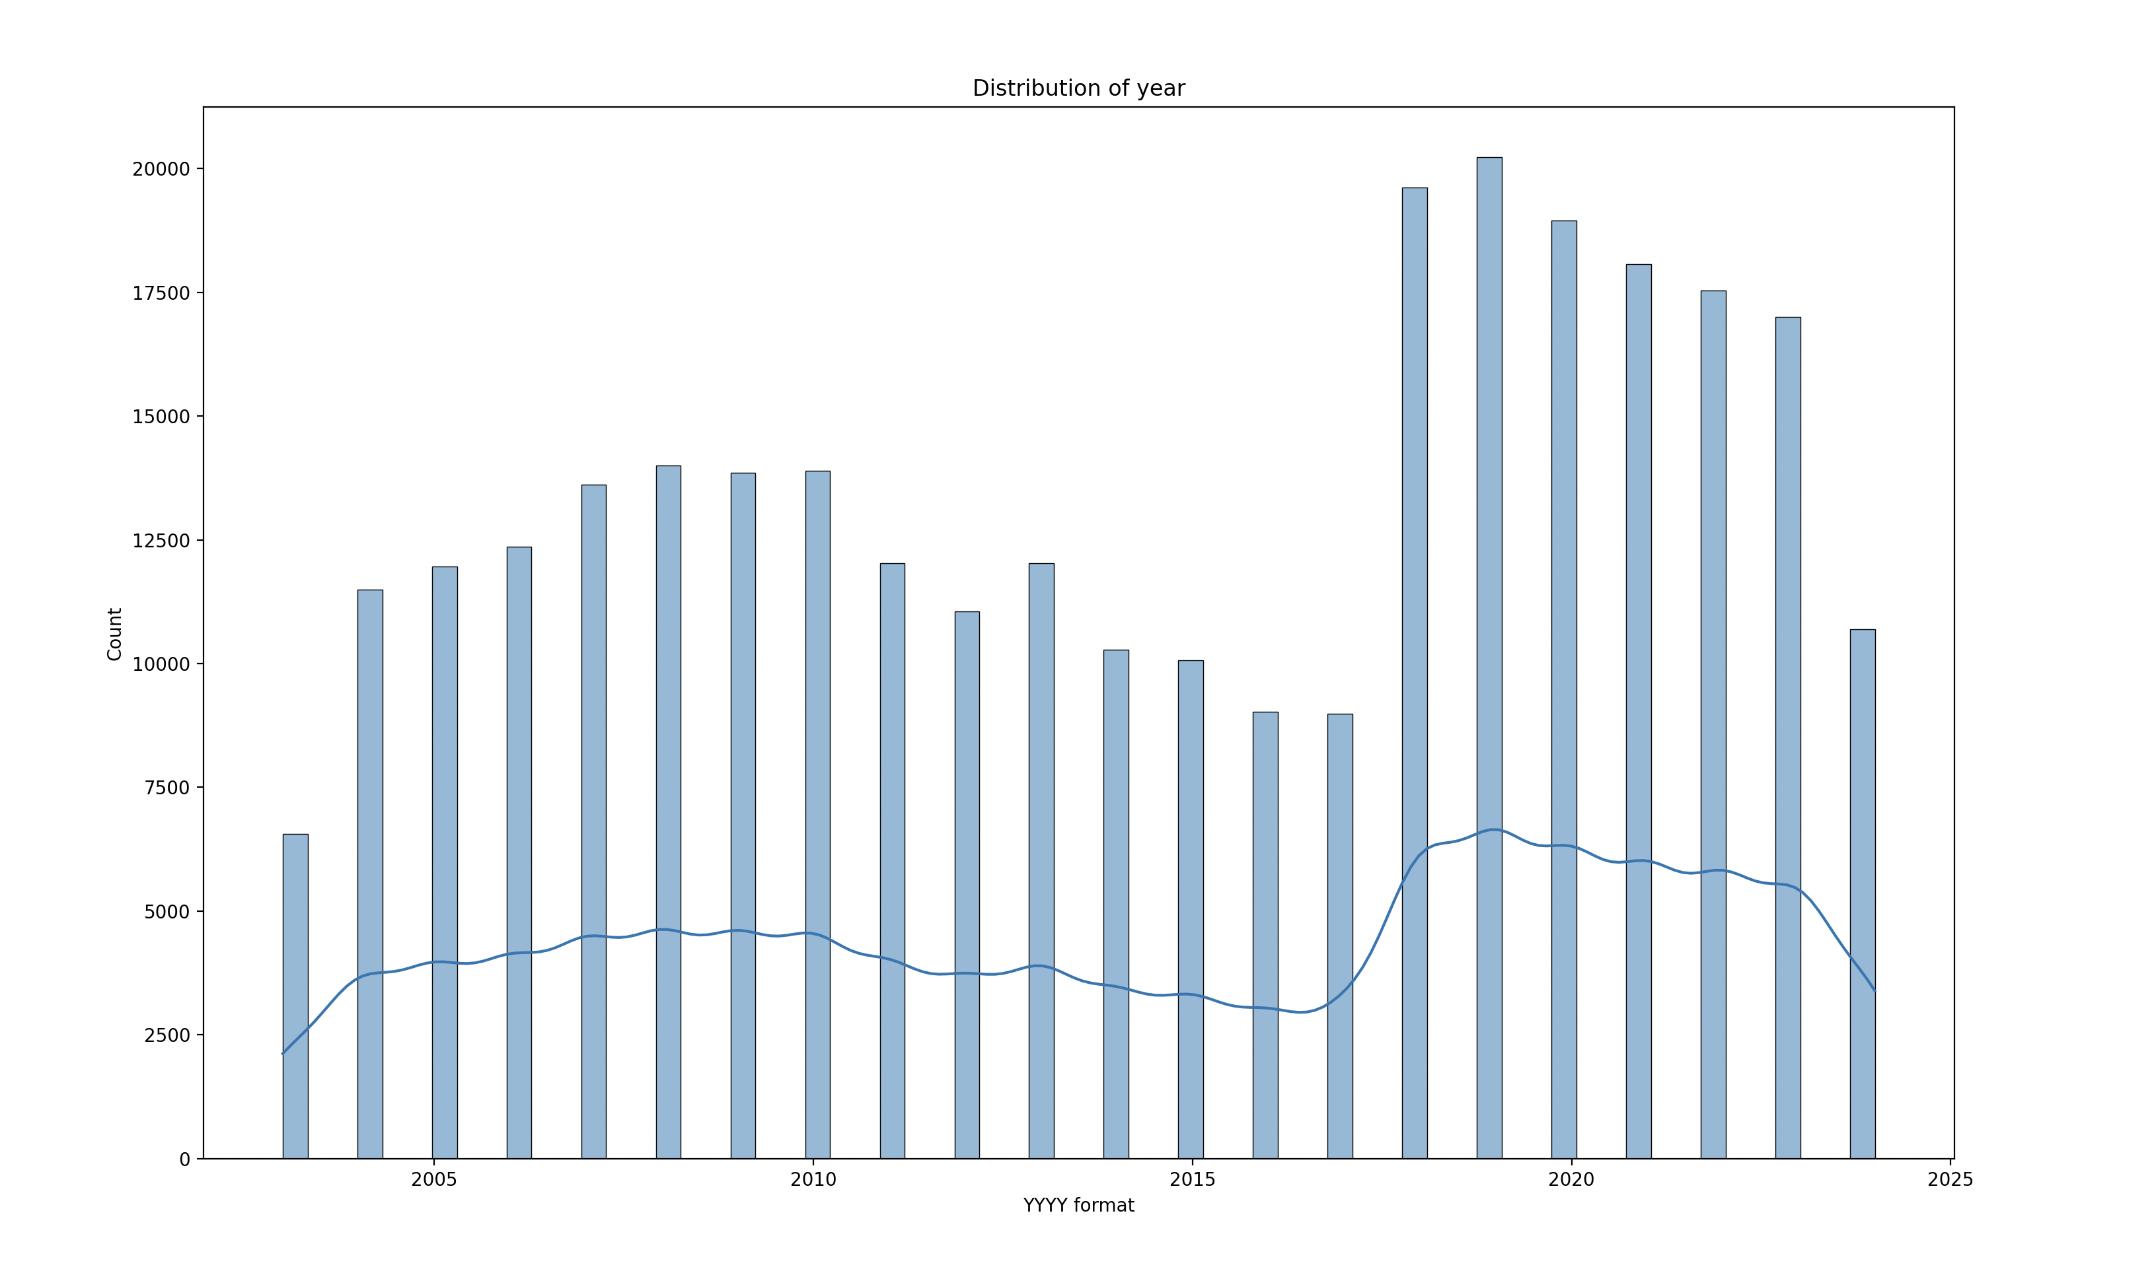

Slide 5
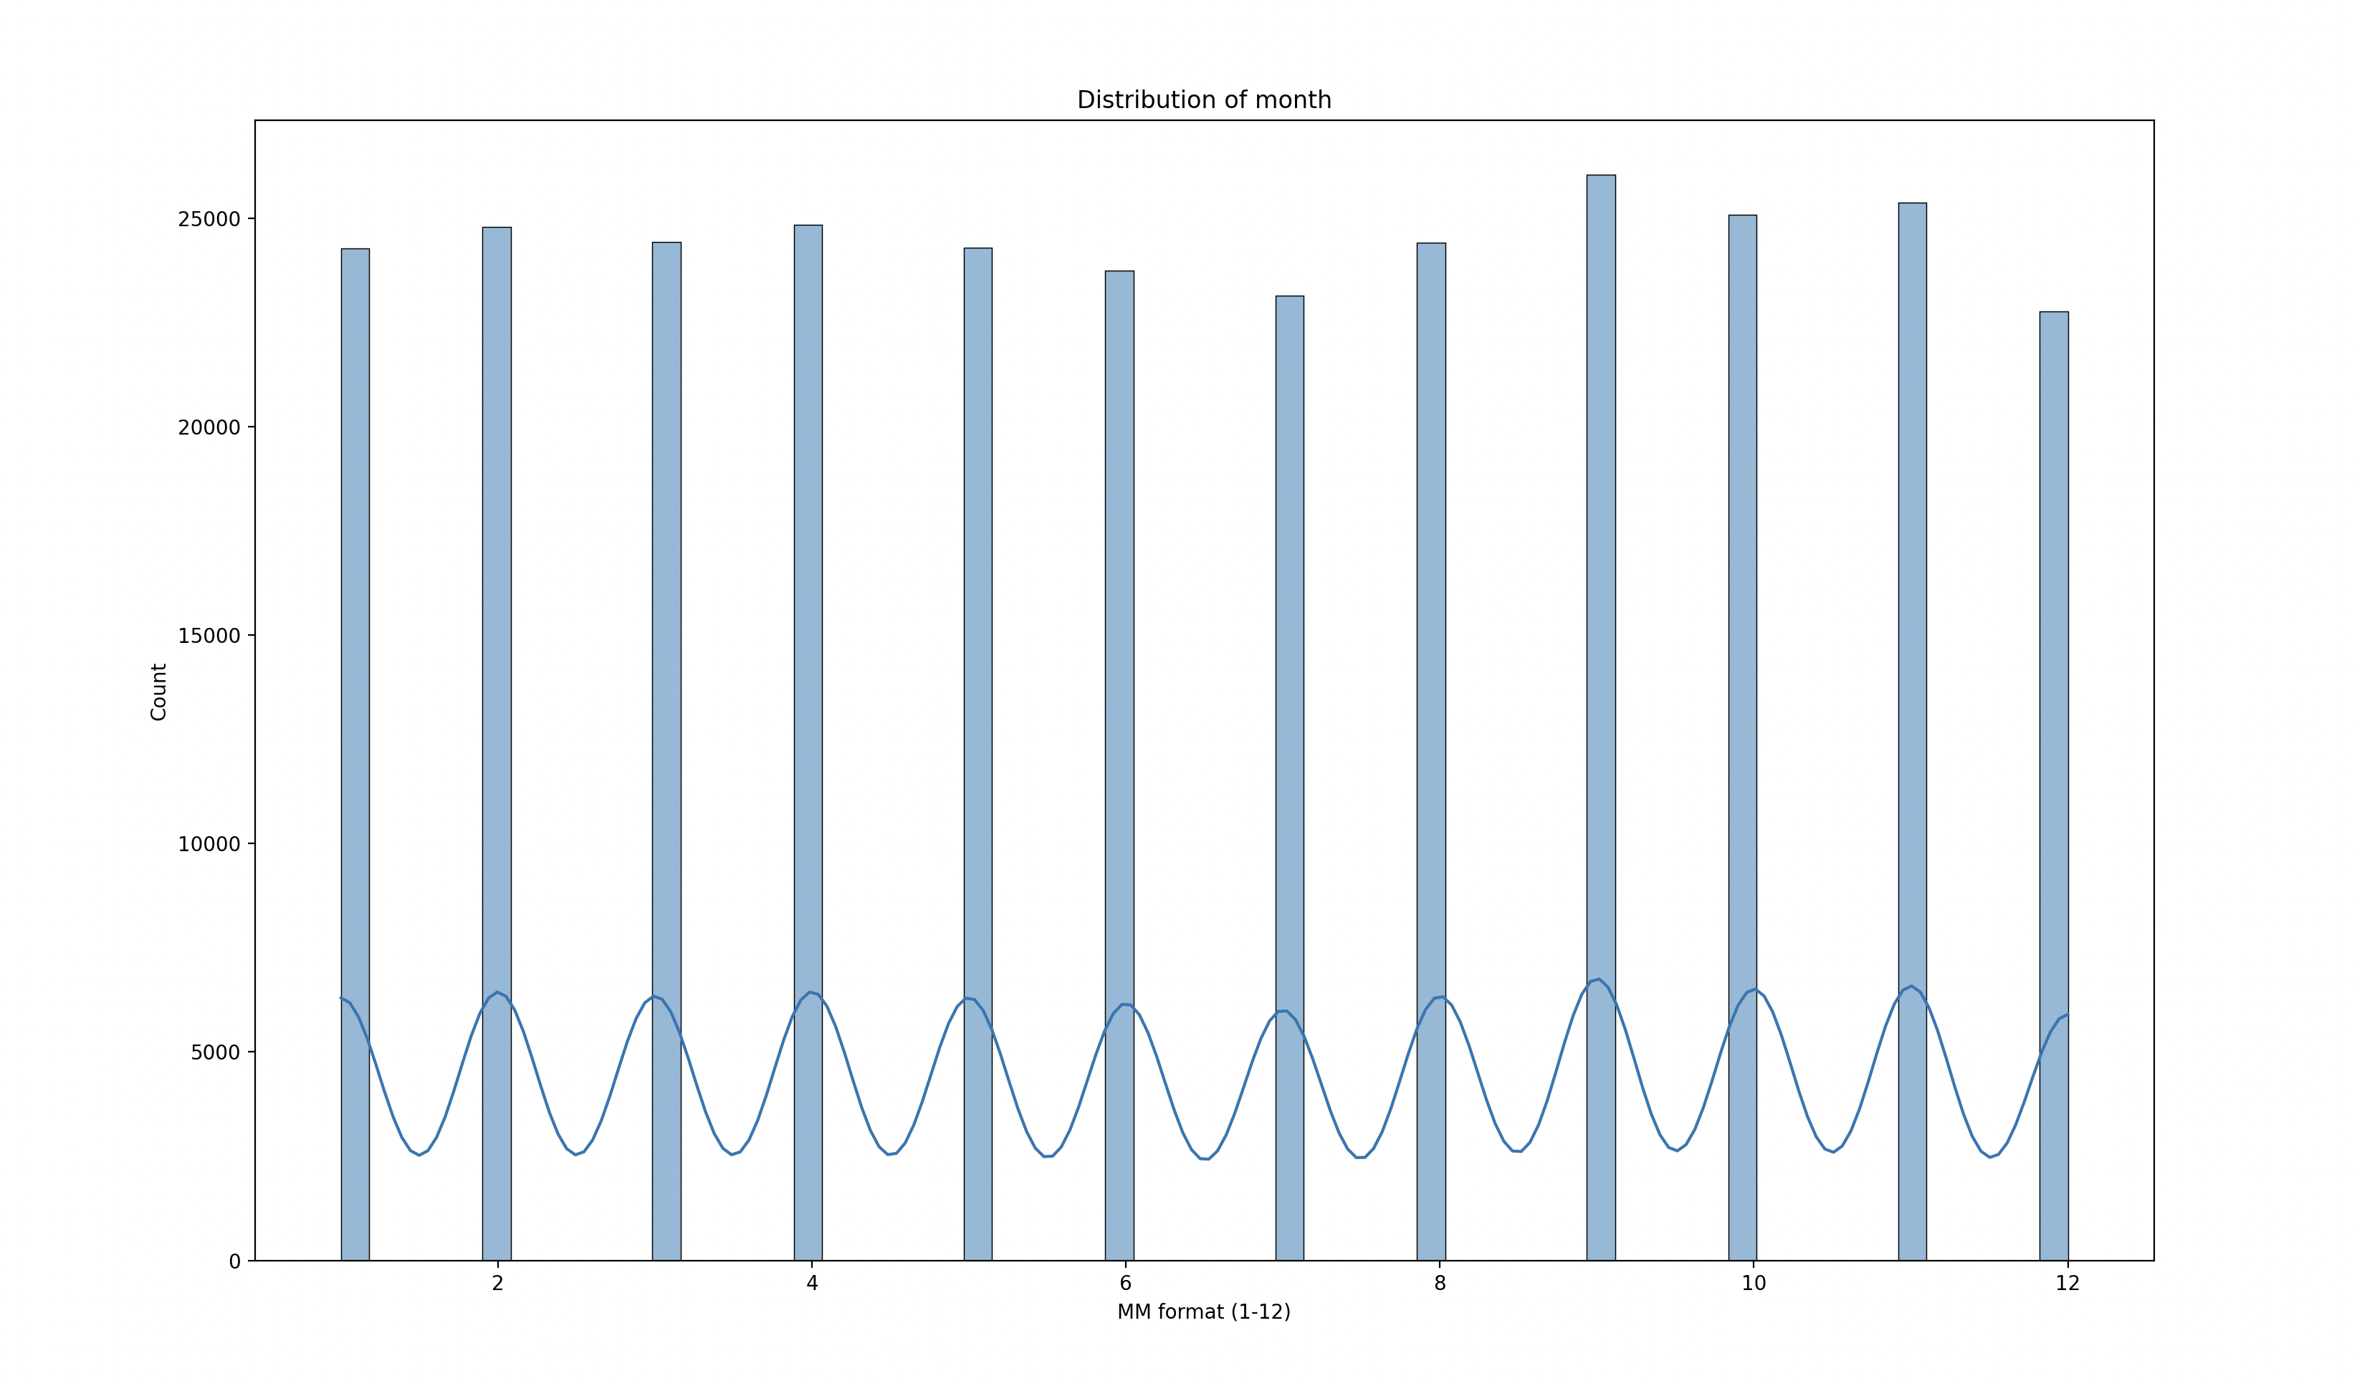

Slide 6
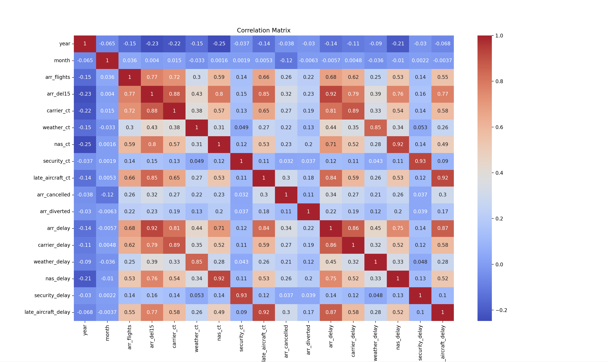

Slide 7
Phase 2: Data Storage and Automation
Optimizing Data Storage
Data Validation
The cleaned data is then stored in a relational database (RDS):
Data validation ensures the integrity of the cleaned data by checking for missing values and validating date formats:
Connection to RDS: We create a connection to an AWS RDS instance using a connection string.
No Missing Values: We assert that there are no missing values in the dataset after cleaning.
Efficient Storage: The data is stored in a table in the RDS database. To optimize query performance, indexes are added on important columns to speed up future queries (e.g., year in this case).
Date Validation: If a date column exists, we ensure that it has been correctly converted into the datetime format.

Slide 8
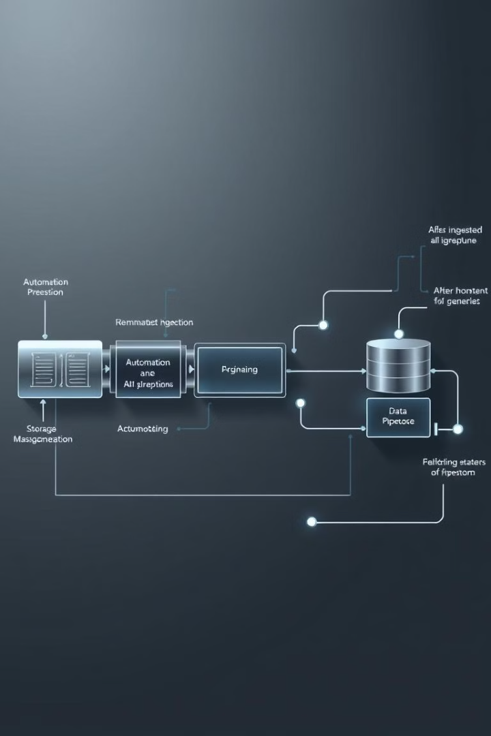
Automation for Periodic Ingestion
1
Scheduled Ingestion:-
2
Automated Execution:-
The data ingestion process is automated using a scheduling library to run at a specific time, ensuring regular updates.
The entire data loading, cleaning, and storage process is automated, eliminating manual intervention.

Slide 9
Phase 3: Advanced Analysis and Transformation
Feature Engineering
Dimensionality Reduction (PCA)
New features are created or existing features are transformed to improve the model's predictive power. This includes creating interaction features, aggregated metrics, and proportions.
Principal Component Analysis (PCA) is used to reduce the dimensionality of the dataset, transforming the data into a smaller set of principal components.
Interaction Features: We create a new feature delay_per_flight,total delays and proportions,severity delay, average delay per flight by dividing the total arrival delay by the number of flights. This helps us analyze delays relative to the number of flights.
Data Transformation: We select numeric columns and apply PCA to reduce the number of features while retaining as much variance as possible.
New Data Representation: The data is transformed into a smaller set of principal components, which are linear combinations of the original features.
Aggregated Metrics: A new feature total_ct is created by summing the various causes of delays (e.g., carrier delays, weather delays).
Proportions: We create proportion-based features to understand the relative importance of each delay cause.

Slide 10
Clustering and Predictive Modeling
Predictive Modeling:-
Clustering:-
A Random Forest Regressor is used to predict arrival delays based on features like flight numbers and delay causes. Model performance is evaluated using metrics like Mean Squared Error (MSE).
K-Means clustering groups similar records based on features like delay per flight and total delay causes. The silhouette score measures the quality of the clusters.

Slide 11
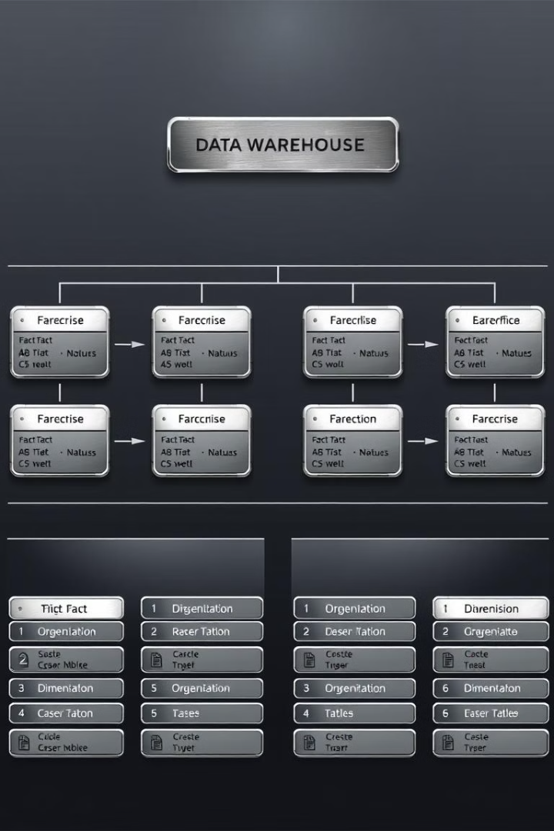
Phase 4: Data Warehousing
Fact Table
Dimension Tables
The transformed data is stored in a fact table, containing the main data used for analysis.
Summarized or categorical data is stored in dimension tables, providing descriptive context to the fact table.
Indexing
Indexes are added to key columns to enhance query performance, especially for frequent queries like filtering by year or month.

Slide 12

Data Governance
1
Data Quality
2
Security
Regular validation scripts ensure data consistency and integrity.
Access to the data is controlled using role-based permissions, and the data is encrypted both in transit and at rest.
3
Compliance
The system ensures compliance with relevant regulations, such as GDPR or CCPA, for privacy and data protection.

Slide 13
Data Integrity Checks
1
Data Consistency: Ensure the data conforms to a predefined standard. This can be implemented by checking for duplicates, or validating that categorical variables have valid values (e.g., ensuring only certain categories are present in a column).
2
Cross-validation of Data: Ensuring that data across different sources or systems align. For example, checking that dates in two different datasets match or that data types are consistent.
Model Evaluation Metrics
1
Random Forest Regressor: In addition to MSE, metrics like R-squared (R²) and Root Mean Squared Error (RMSE) could be mentioned for a more comprehensive evaluation.
2
K-Means Clustering: Apart from Silhouette Score, other metrics like the Davies-Bouldin Index or Elbow Method for determining the optimal number of clusters can also be discussed.

Slide 14
Phase 5: Data Visualization
Line Plots: Time series trends.
Bar Charts: Contributions of delay causes and top contributors.
Boxplots: Variability and outliers in delay causes.
Count Plot: Delay severity distribution.

Slide 15
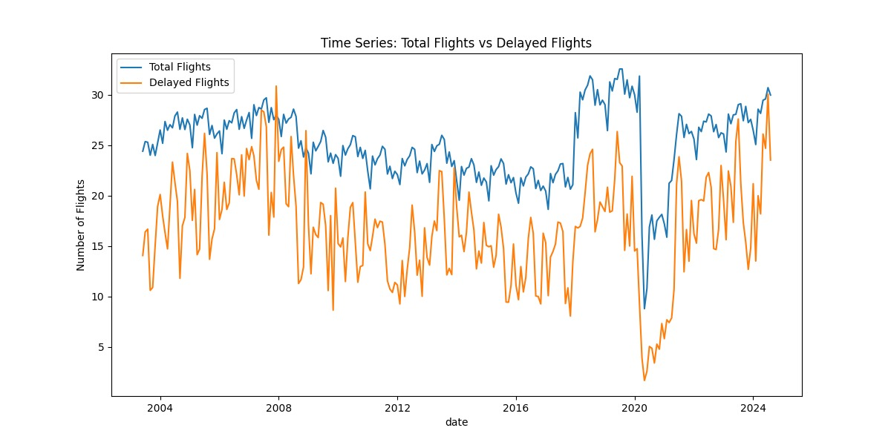

Slide 16
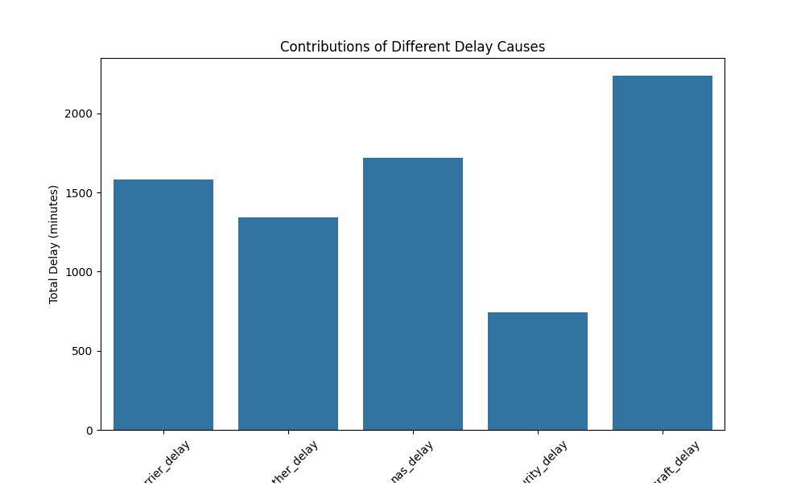

Slide 17
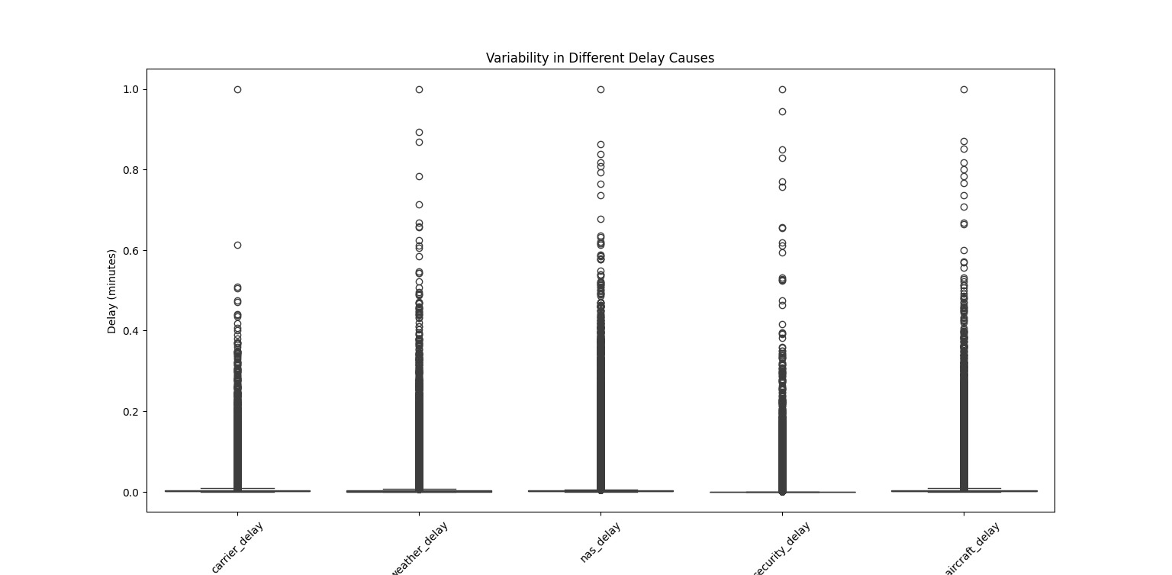

Slide 18
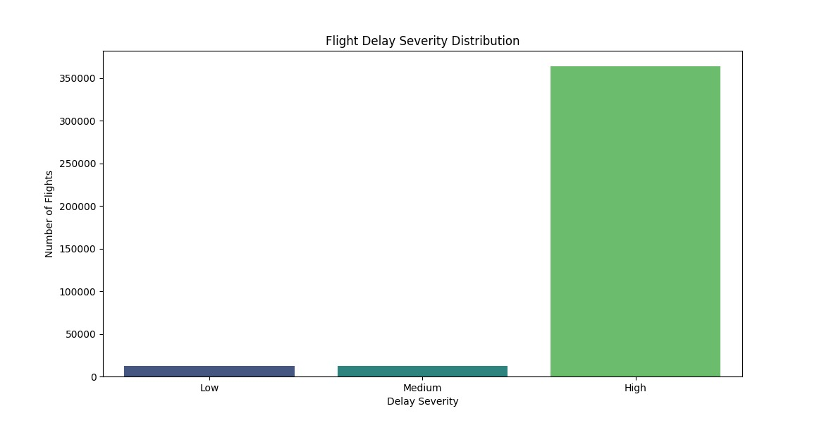

Slide 19
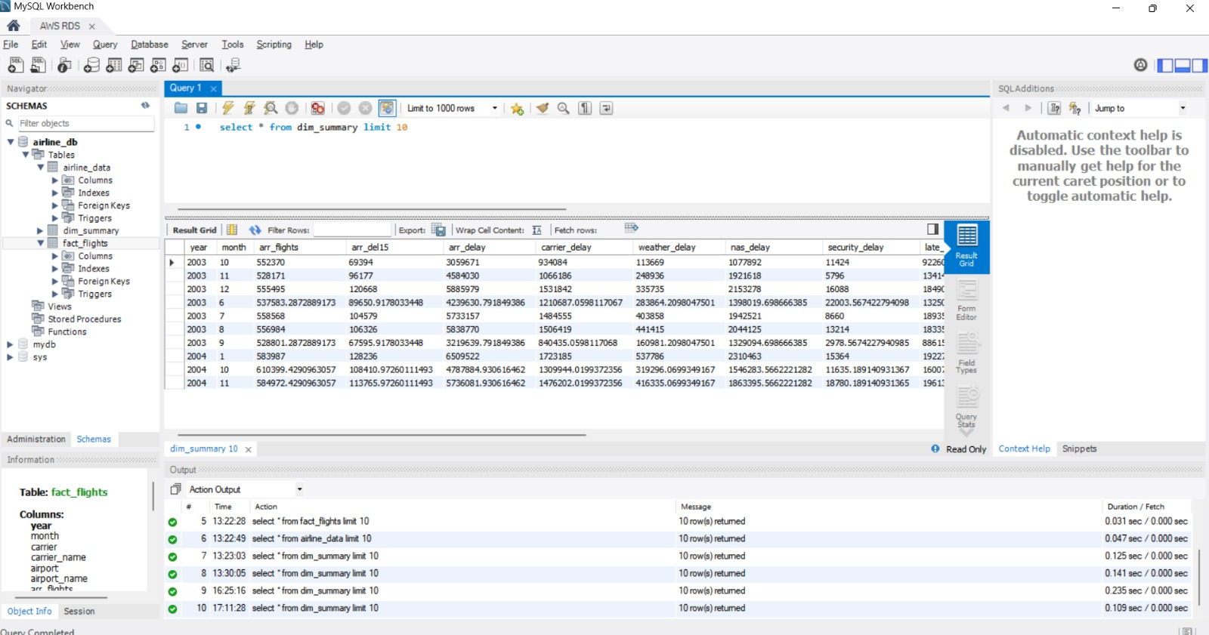

Slide 20
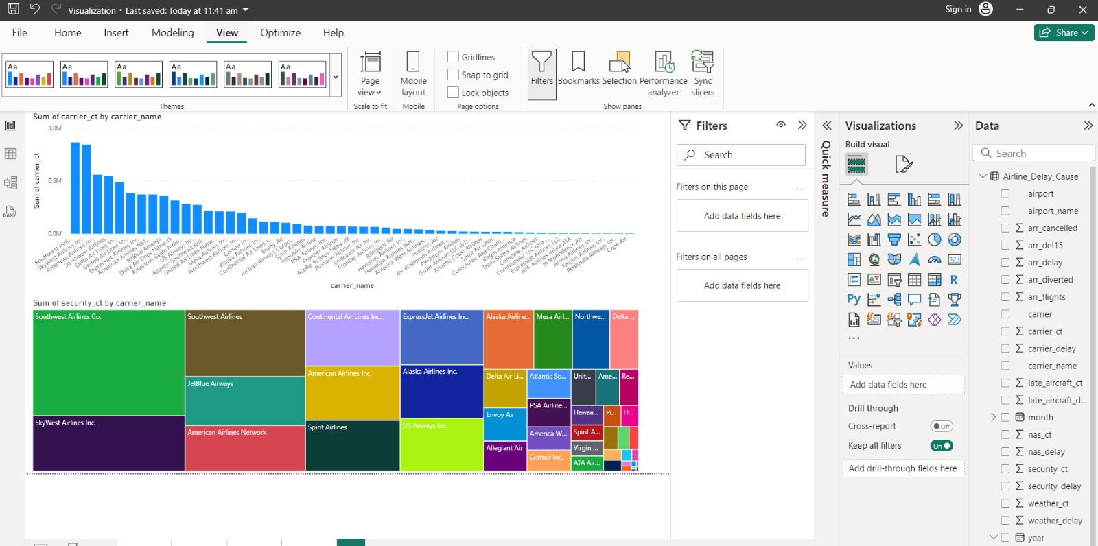

Slide 21
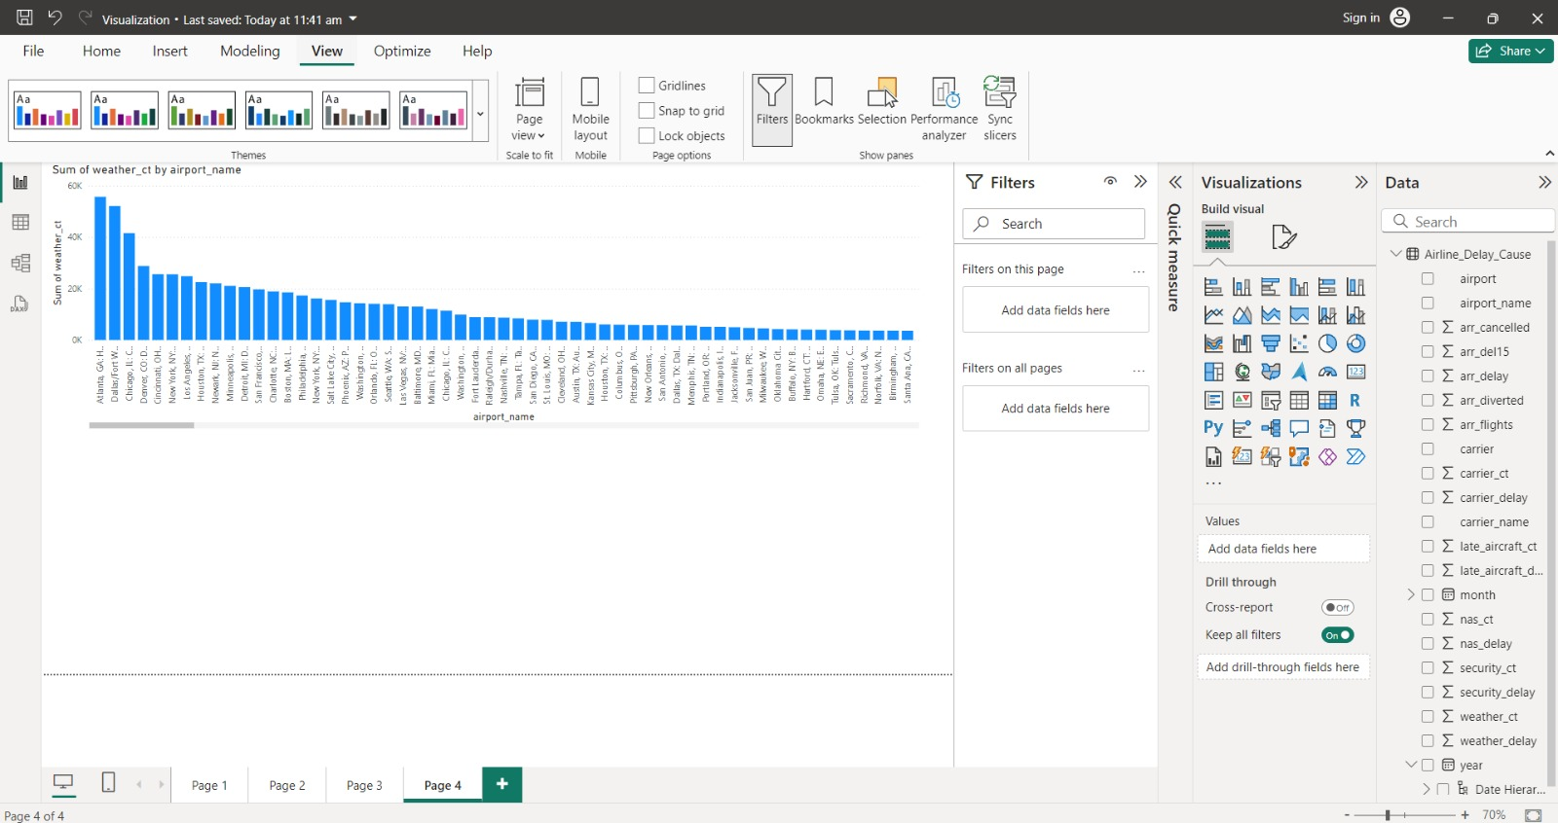

Slide 22
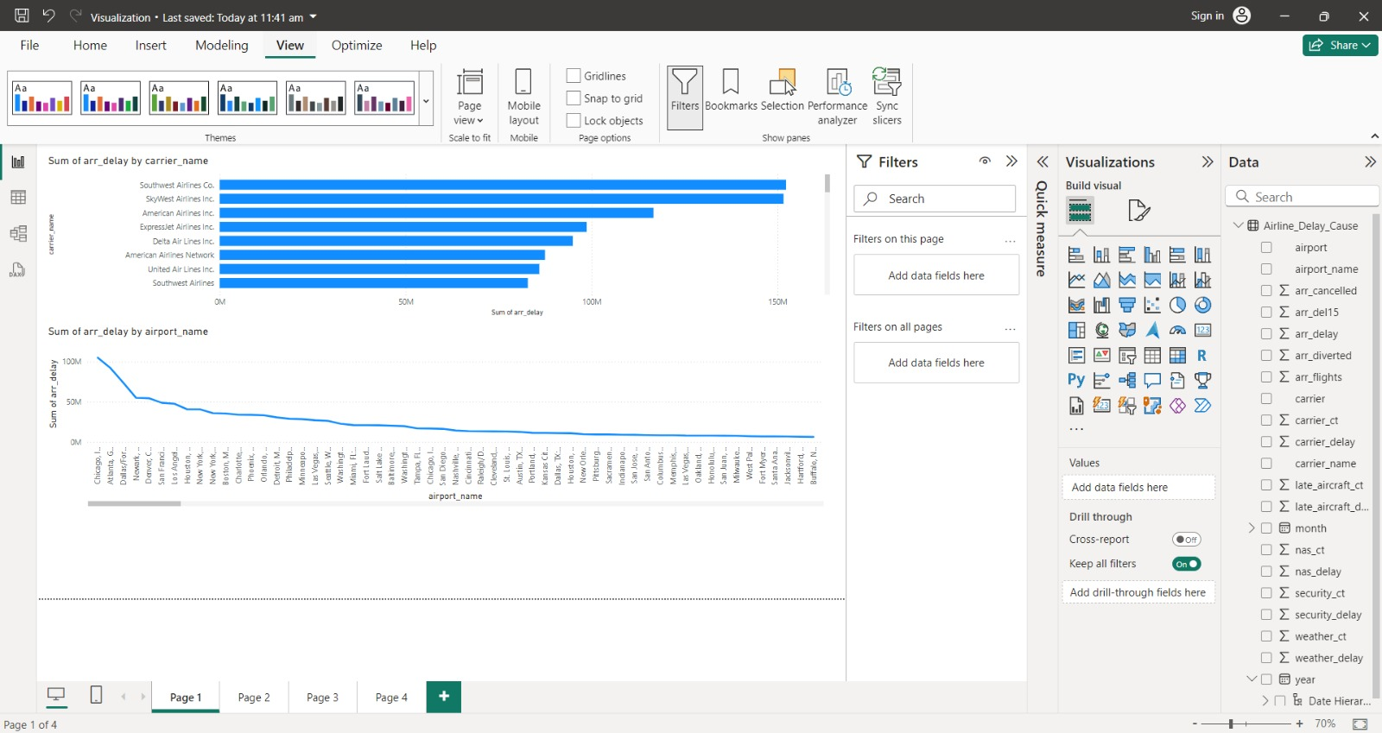

Slide 23
THANK YOU!!

